Slide 1
Density of Restaurants
Dallas

Slide 2
BUSINESS PROBLEM
Opening a restaurant is all about location, location, location. However, not every restaurant is suitable for every location, and vice versa. It comes down to a combination of restaurant concept and ideal customer. If we can define our restaurant type and identify our target demographic and its most populated areas, we can make a good decision on where to open the restaurant.

Slide 3
INITIAL STEPS
1. Describe Your Customers
Demographics – Information such as age, gender, relationship status, median income, religion, environment, and ethnicity
Psychographics – Consumer personality type and personal preferences
Behavior – Similar behavior, such as likes and dislikes, hobbies, and extracurricular activities
2. Understand Their Habits
3. Where Are They Located?
4. Are There Enough of Them?
5. Customer Activity: Foot & Vehicle Traffic
6. Competitor Analysis

Slide 4
DATA REQUIRED FOR
Competitor analysis.
If there are already three pizza restaurants on a street, you’ll want to think long and hard before opening a fourth. There are no hard and fast rules on what constitutes market saturation. However, a good rule of thumb is whether or not you believe that your restaurant could thrive without taking away a big chunk of business from another good restaurant.
We are going to use Foursquare location data to find where are most fast food restaurants are located.
Complimentary restaurants
Complimentary restaurants have concepts that are different from your restaurant, but their price points are often in the same range as your own. These complimentary restaurants help establish specific areas within a community that offer multiple eating options. Customers often seek out these areas to window shop and find what they’re craving in the moment. Sometimes your customers will eat with the complimentary restaurants, and other times they’ll eat with you. The benefit, however, is that complementary restaurants are less competitive than restaurants with the same concept as yours.

Slide 5
DATA SOURCES
www.geonames.org
URL: http://www.geonames.org/search.html?q=Dallas&country=US
FOURSQUARE API

Slide 6
DATA CLEANUP
Remove unnecessary data
Format data

Slide 7
ANALYSIS
We get the population of each neighborhood from the webpage and we get the number of restaurants in each of those neighborhoods using the Foursquare API. We calculate the density as the population of the neighborhood divided by the number of restaurants in the neighborhood.

Slide 8
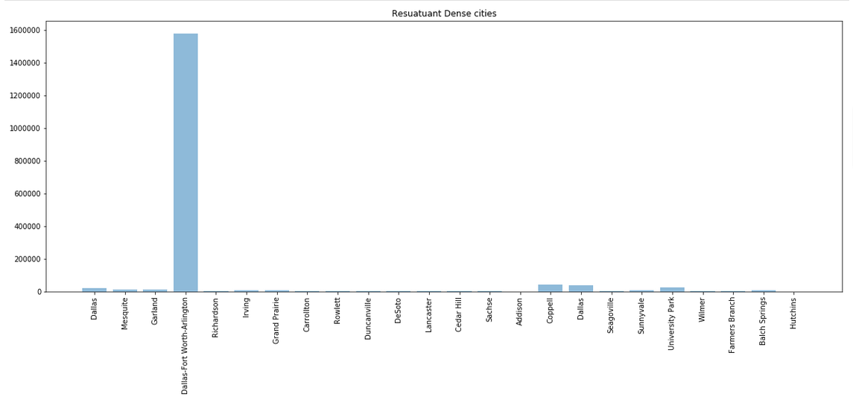
Results

